Slide 1

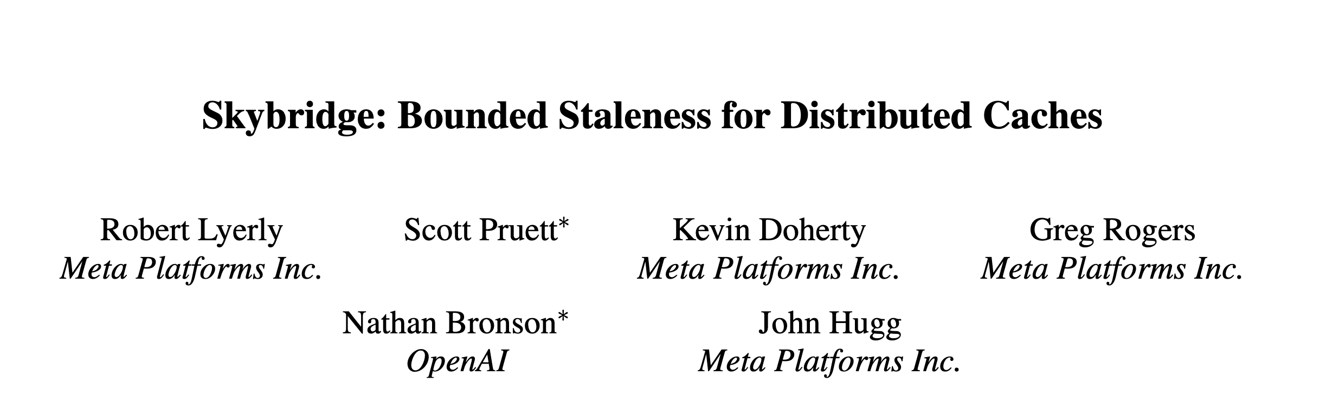

Slide 2
INTRODUCTION
Background
Meta’s datastore hosts millions of database shards and handles billions of queries per second at sub-second latency.
Meta operates instances of the serving stack in multiple geographic regions worldwide.
Meta uses asynchronous replication to keep copies synchronized in order to meet our strict latency and high scalability requirements.
Asynchronous replication provides eventual consistency for clients.

Slide 3
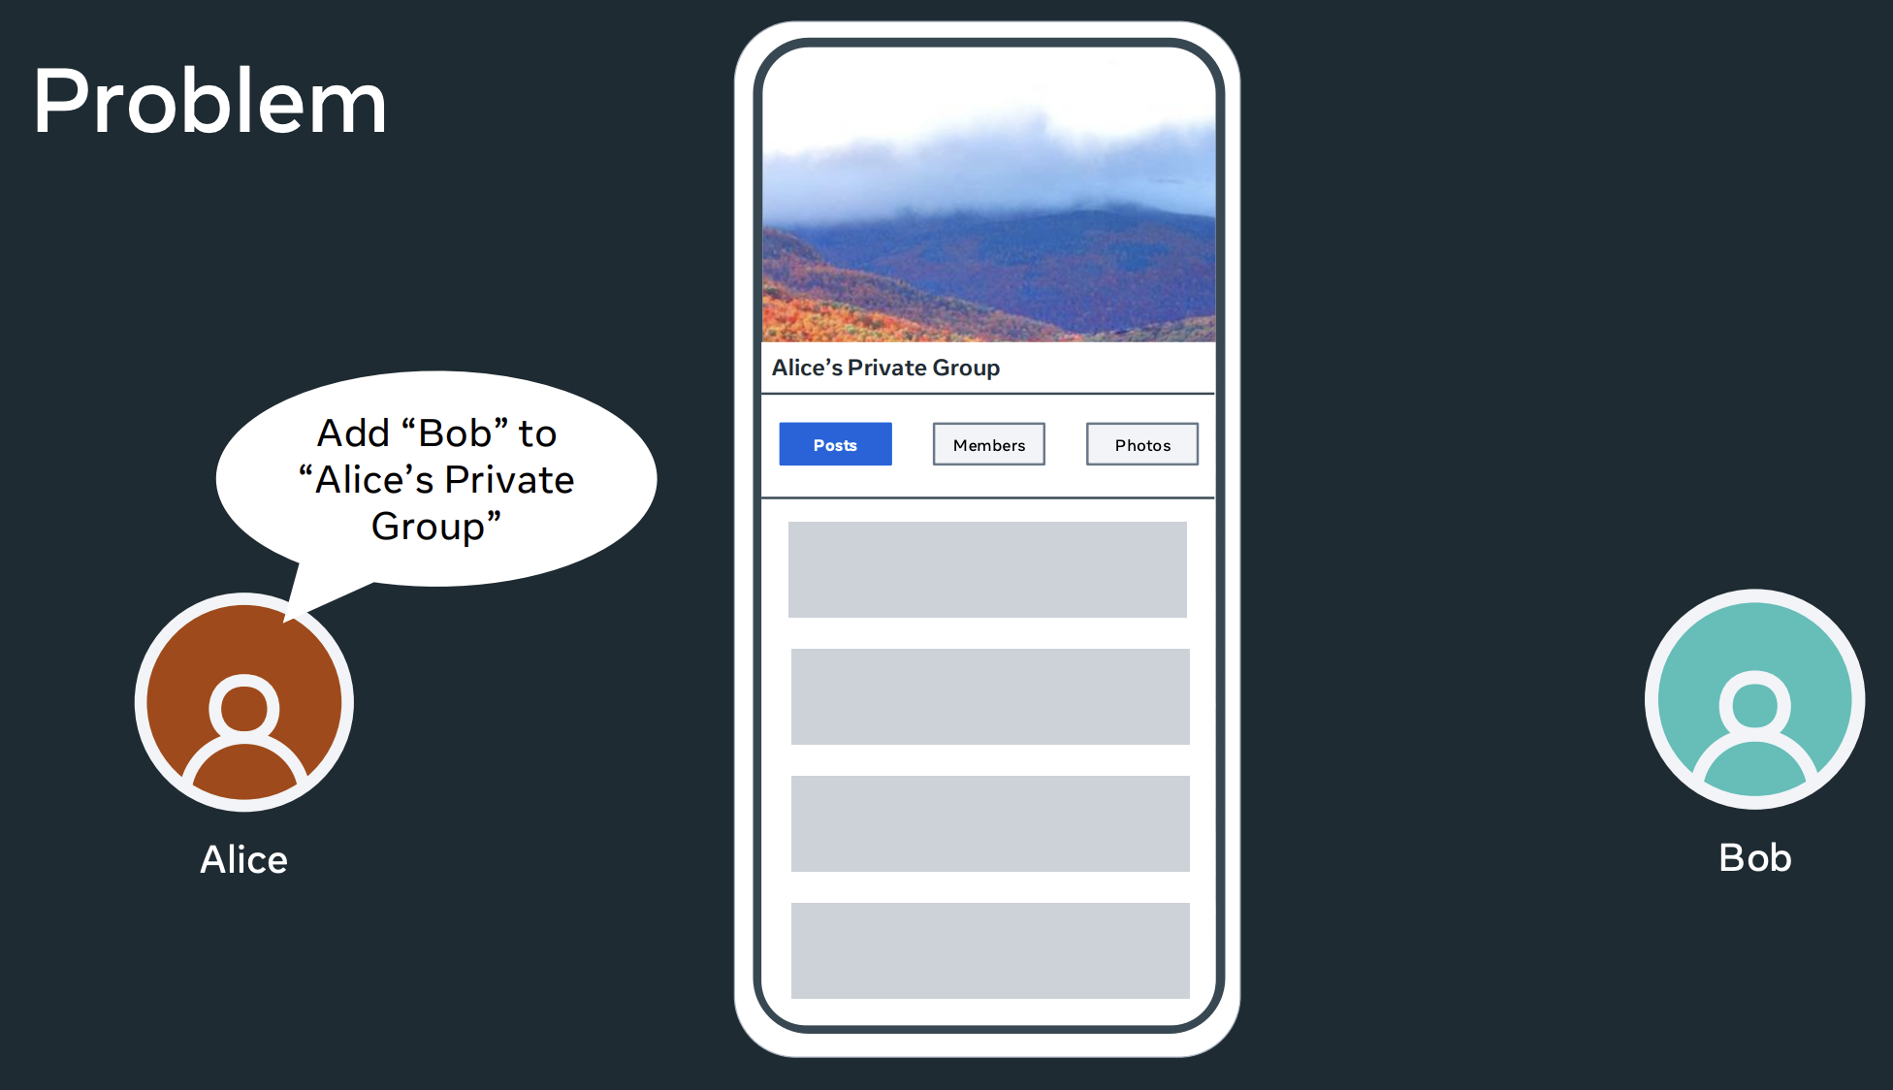

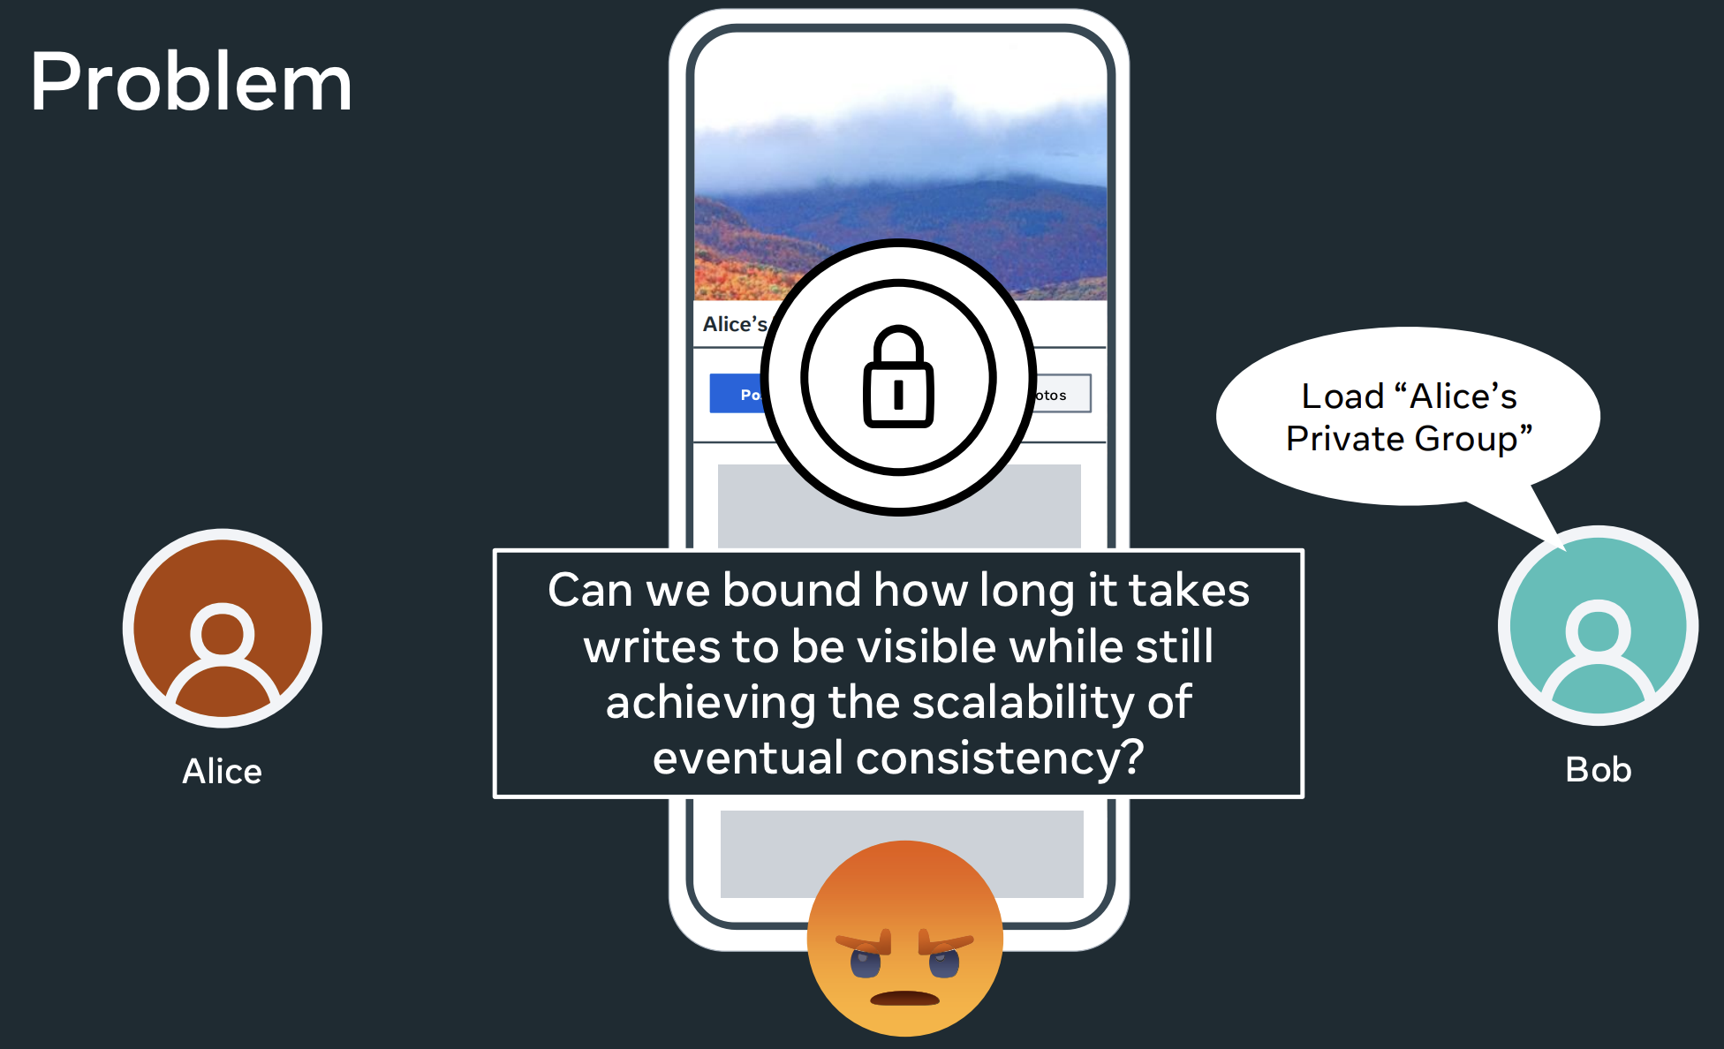
INTRODUCTION
Background
Eventual consistency is a recurring pain point. For Meta, eventual consistency causes bad user experiences in products.
Developers often ask “what is the maximum cross-region replication lag?”

Slide 4
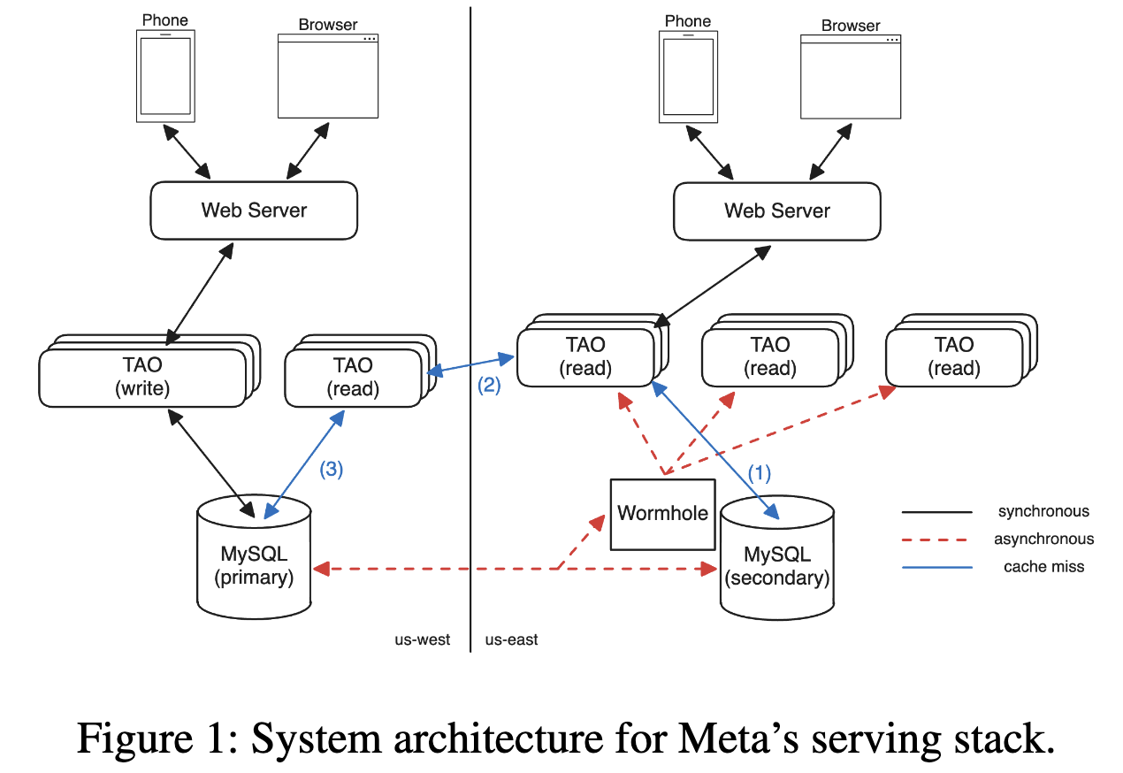
INTRODUCTION
Meta’s system architecture
Storage. Meta stores its user data in MySQL with primary-secondary replication.
Caching. Meta operates an in-memory caching service named TAO, which separated into read and write tiers.
Write versioning. Meta’s datastores use hybrid-logical clocks (HLC).
MySQL injects a heartbeat message (with HLC) into the replication stream every 500ms.

Slide 5
INTRODUCTION
Contribution
Explain why bounded staleness is important for TAO’s users and why we did not target other forms of consistency.
Define a novel replication guarantee called replication with gap detection that focuses on detecting cache staleness.
Describe Skybridge’s design and implementation, a system that provides fine-grained and efficient bounded staleness for distributed in-memory caches.
Increase 2-second consistency from 99.993% to 99.99998% using Skybridge.

Slide 6
INTRODUCTION
Bounded staleness
Bounded staleness guarantees that reads will observe any write within some system-provided time bound.
Why bounded staleness?
Bounded staleness matches most users’ mental model of the system.
Stronger forms of consistency like linearizability, sequential consistency and causal consistency introduce too much communication and synchronization overhead.

Slide 7
INTRODUCTION
Bounded staleness
Picking a staleness bound.
Setting the bound to 2 seconds struck the right compromise between usability and feasibility. It is both a useful human-scale time bound and is achievable given speed-of-light delays for cross region replication.

Slide 8
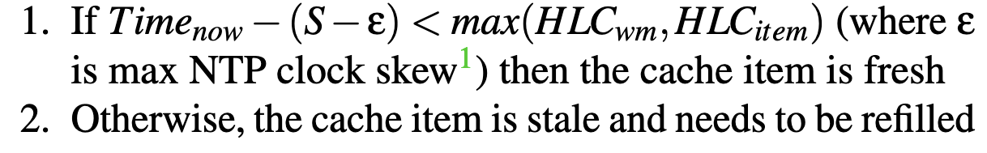
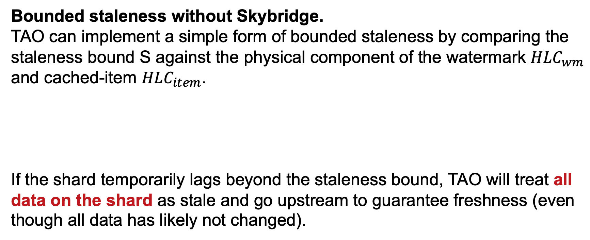
INTRODUCTION
Bounded staleness
Bounded staleness without Skybridge.
TAO can implement a simple form of bounded staleness by comparing the staleness bound S against the physical component of the watermark $HLC_{wm}$ and cached-item $HLC_{item}$.
If the shard temporarily lags beyond the staleness bound, TAO will treat all data on the shard as stale and go upstream to guarantee freshness (even though all data has likely not changed).

Slide 9
DESIGN
Replication with gap detection
Skybridge’s goal is to be a fine-grained staleness oracle for TAO.
Replicating write metadata. RGD systems only need the write metadata, i.e., cache key (node or edge ID) and DB HLC minted by the DB, to identify stale cache entries.
Known data loss. If the RGD system reports an “indeterminate” result (i.e., it is missing data), the cache can always conservatively assume it is stale and refill the entry.
Out-of-order replication. The data in the replication stream is a conflict-free replicated data type (CRDT), whose updates are idempotent, associative and commutative.

Slide 10
DESIGN
Replication with gap detection
RGD replication streams are add-only set CRDTs containing write metadata represented by <key, HLC> tuples.
At read time, clients query the RGD system by key. If there are multiple <key, HLC> tuples in the set, the writes are merged using a last-write-wins strategy.

Slide 11
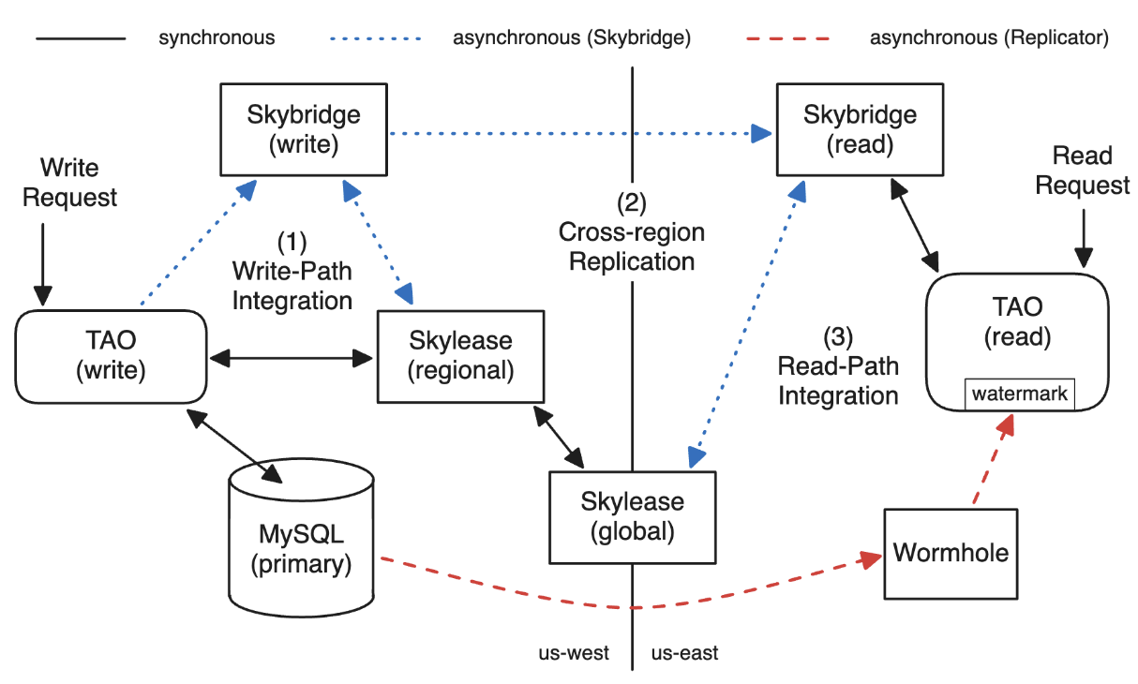
DESIGN
Skybridge architecture

Slide 12
DESIGN
Skybridge architecture: Write path
Skybridge’s goal on the write path is to ingest metadata about all writes committed to the DB.
Skybridge uses a leasing system called Skylease to track which hosts are writing to which shards.
A writer is only allowed to write to a shard if it has an open lease and the host promises to send heartbeats for the duration of the lease. Then it writes all data for the duration of the lease, forming a write window.
Notes:
类似一致性协议，在每个租期内 lease 构建 writer 和 shard 的写入关系，并要求 writer 完整地写入这个租期的所有数据。他通过心跳来保证这一点。但注意，不同租期之间的数据是异步的，也就可能出现一个新租期的数据都写了，旧租期还没有写入。但这无所谓，因为 skybridge 会发现旧租期的 lease 还没全部完成、数据还没有全部写入，对应 shard 的数据就可能是不新鲜的。

Slide 13
DESIGN
Skybridge architecture: Cross-region replication
While TAO writers push windows to the local Skybridge tier, cross-region subscribers pull a short continuous stream of write windows from publishers in the primary region to fill their indexes.
Using a pull model gives subscribers the ability to quickly detect gaps and re-fetch windows from another source.
Notes:
类似一致性协议，在每个租期内 lease 构建 writer 和 shard 的写入关系，并要求 writer 完整地写入这个租期的所有数据。他通过心跳来保证这一点。但注意，不同租期之间的数据是异步的，也就可能出现一个新租期的数据都写了，旧租期还没有写入。但这无所谓，因为 skybridge 会发现旧租期的 lease 还没全部完成、数据还没有全部写入，对应 shard 的数据就可能是不新鲜的。

Slide 14
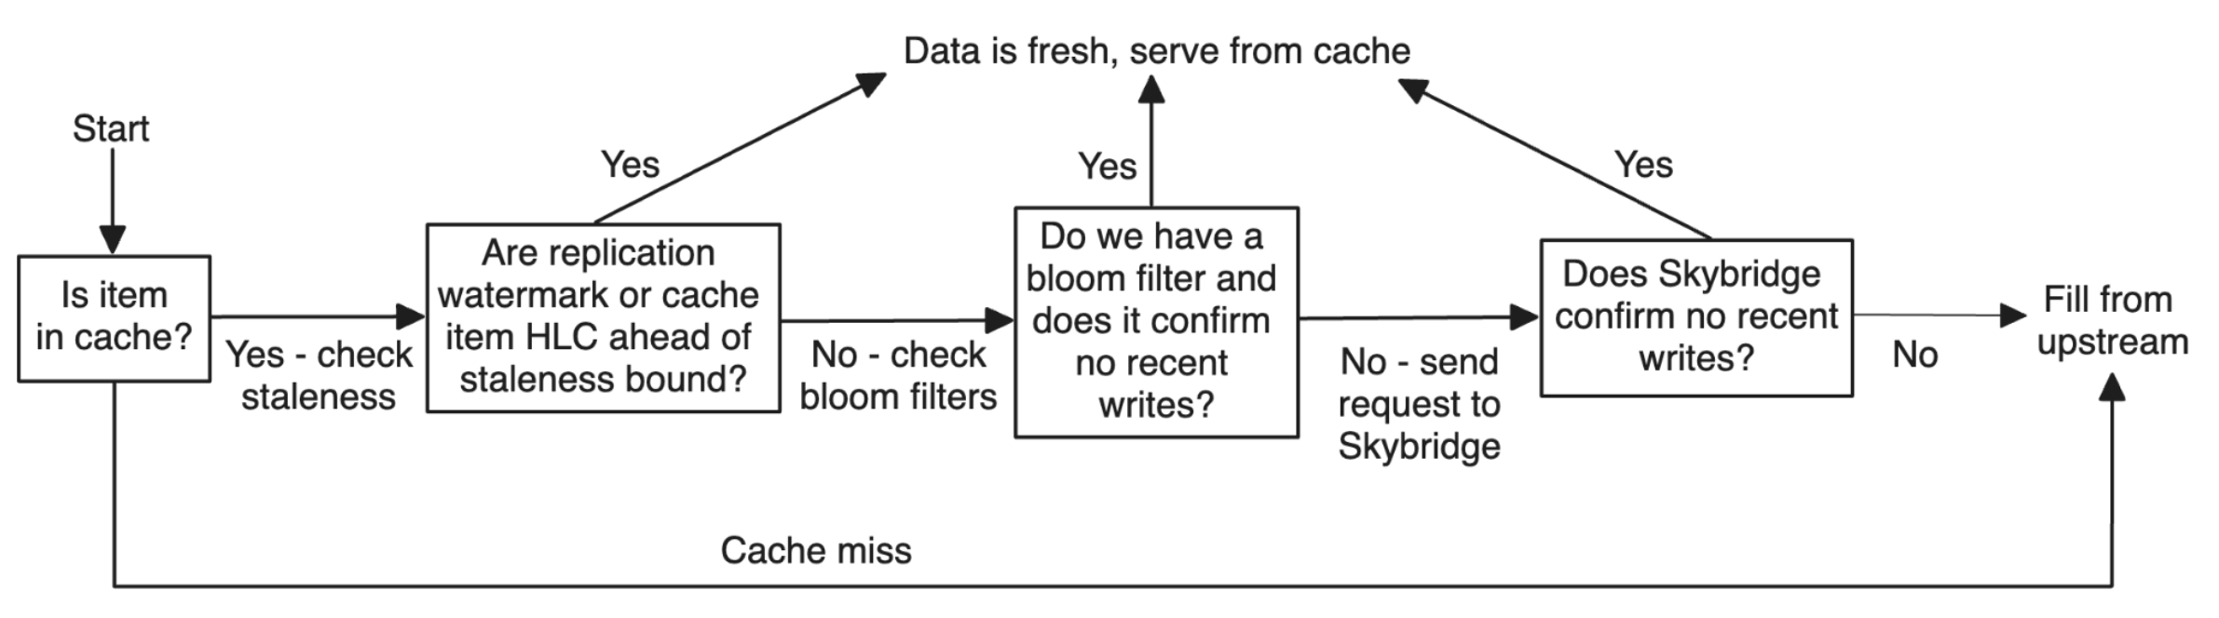
DESIGN
Skybridge architecture: Read path
TAO can proactively load Skybridge’s indexes for lagging shards and construct a bloom filter accordingly.
Thus, it can perform staleness checks locally rather than sending requests to Skybridge
Notes:
类似一致性协议，在每个租期内 lease 构建 writer 和 shard 的写入关系，并要求 writer 完整地写入这个租期的所有数据。他通过心跳来保证这一点。但注意，不同租期之间的数据是异步的，也就可能出现一个新租期的数据都写了，旧租期还没有写入。但这无所谓，因为 skybridge 会发现旧租期的 lease 还没全部完成、数据还没有全部写入，对应 shard 的数据就可能是不新鲜的。

Slide 15
EVALUATIONS
Setup.
TAO runs in tens of regions around the world, handling millions of write queries and billions of read queries per second.
2-second staleness
TAO writers send a sample of writes to an in-region checker instance. On receiving a write, the checker sleeps for 2 seconds from the write’s HLC and then issues read requests for that write to all TAO tiers in all regions:
No bounded staleness;
Blind, i.e., normal read using Skybridge;
Fail-closed, i.e., returning error if it cannot guarantee bounded staleness.

Slide 16
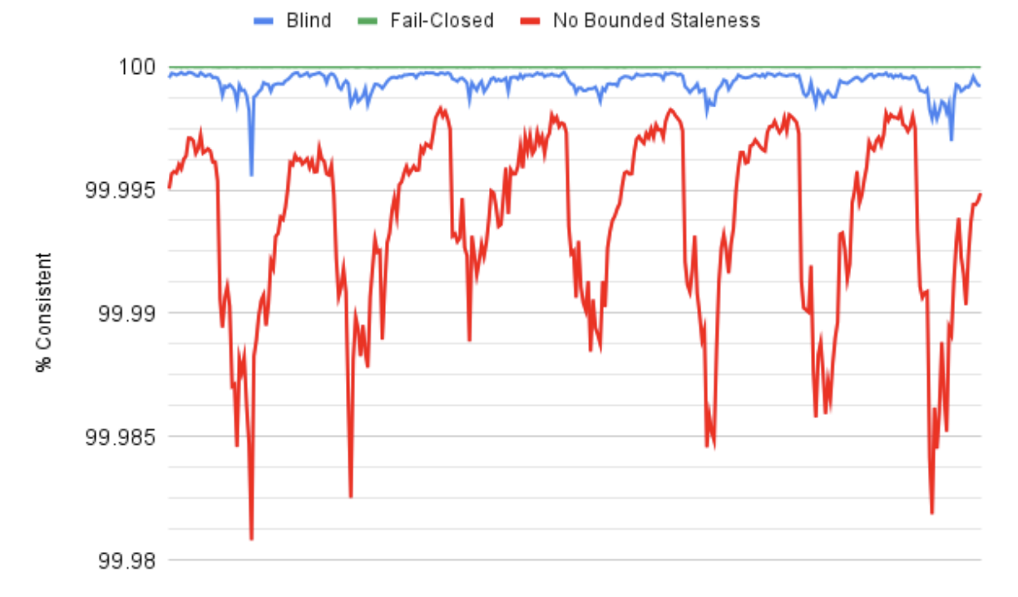
EVALUATIONS
2-second staleness improvements
The main limiting factor preventing better consistency is TAO’s bounded staleness rate limits, which causes Skybridge to fall back to the case without itself (fail open).

Slide 17
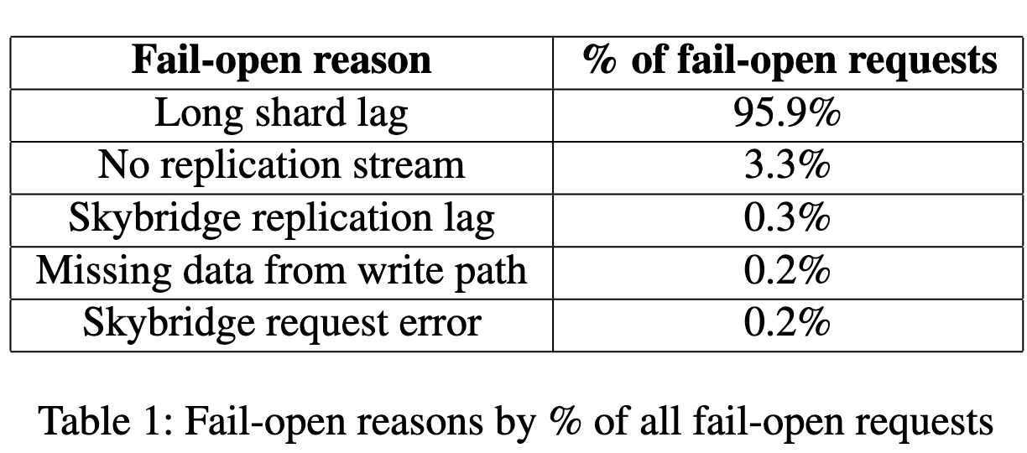
EVALUATIONS
2-second staleness improvements
The main limiting factor preventing better consistency is TAO’s bounded staleness rate limits, which causes Skybridge to fall back to the case without itself (fail open).

Slide 18
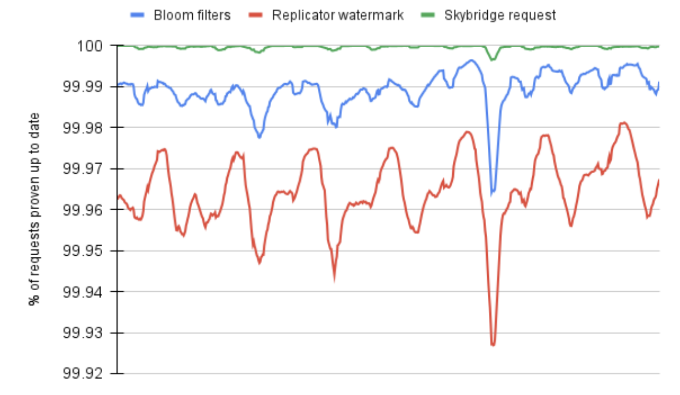
EVALUATIONS
Traffic analysis
Overall, Skybridge is able to provide staleness bound checking with low-overhead, with only 0.0004% of requests needing to go upstream to get fresh data.

Slide 19
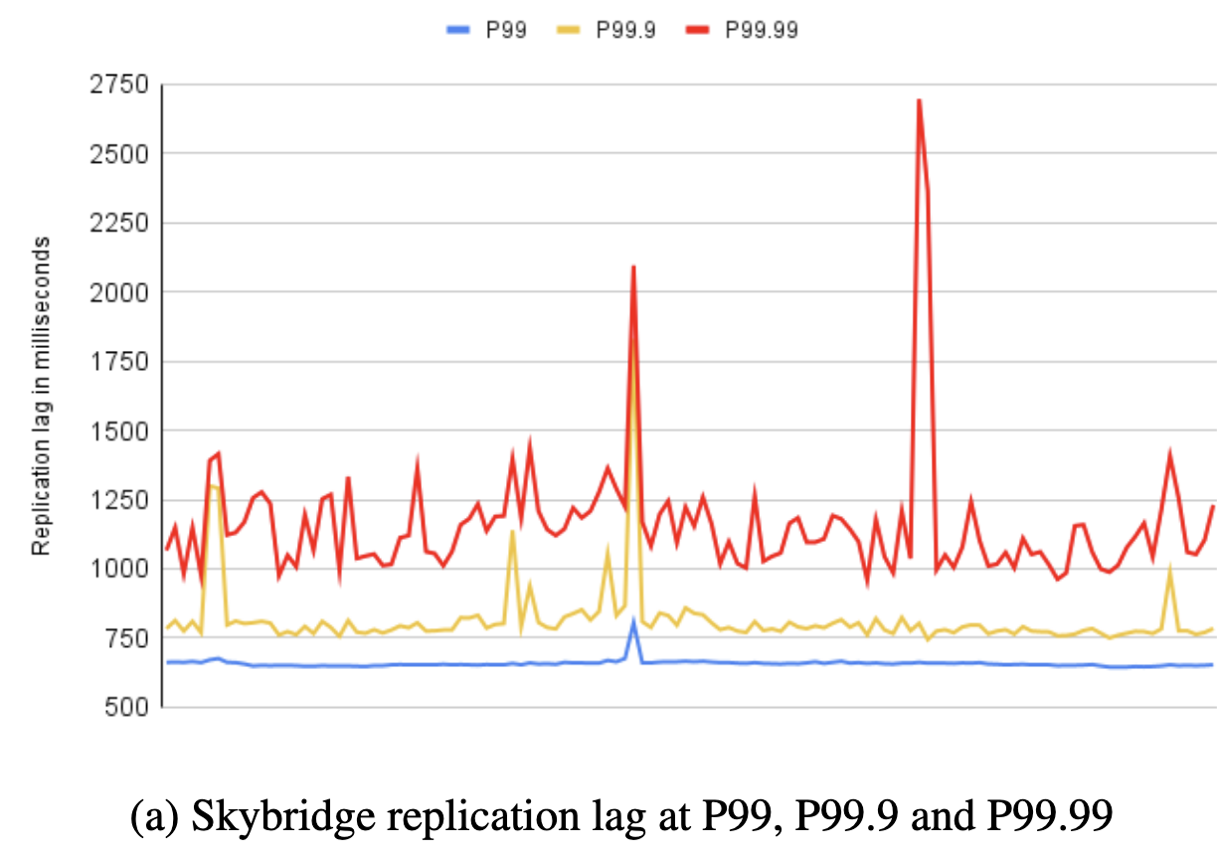
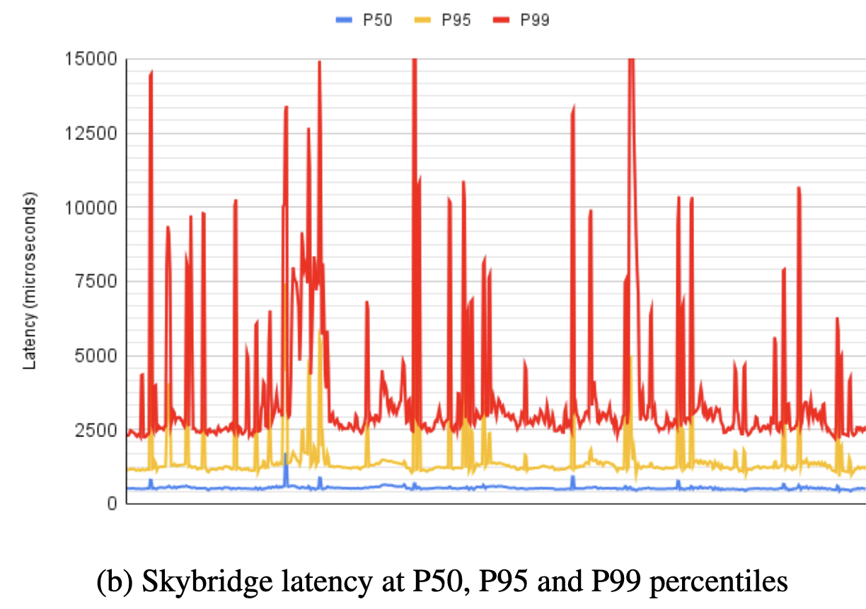
EVALUATIONS
Replication and footprint
The entire Skybridge ecosystem (Skybridge read and write path, regional and global Skylease) uses 0.54% of TAO’s server footprint.

